Slide 1
Engineering Design Portfolio
Arturo A. Brito | (305) 915- 0503 | arturoalberto911@yahoo.com

Slide 2
Table of Contents
Space Telescope Science Institute Experience
HiCAT Testbed Configuration Overview
Tip-Tilt Apodizer Mount
Phase Retrieval Camera Mount
Initial Mirror Mount vs. Upgraded Mirror Mount
Imaging Camera Mount
LUVOIR Lyot Stop Mask
Sheetmetal Laser Cover
Johns Hopkins Senior Design Project
Project Overview
Drill Press Testing Set Up
Door Testing Apparatus
Senior Design Team Poster
Design and Analysis of Dynamic Systems Lab Research
Inverted Pendulum
Videos of Inverted Pendulum

Slide 3
Space Telescope Science Institute Experience
HiCAT Testbed Configuration Overview
Tip-Tilt Apodizer Mount
Phase Retrieval Camera Mount
Initial Mirror Mount vs. Upgraded Mirror Mount
Imaging Camera Mount
LUVOIR Lyot Stop Mask
Sheetmetal Laser Cover

Slide 4
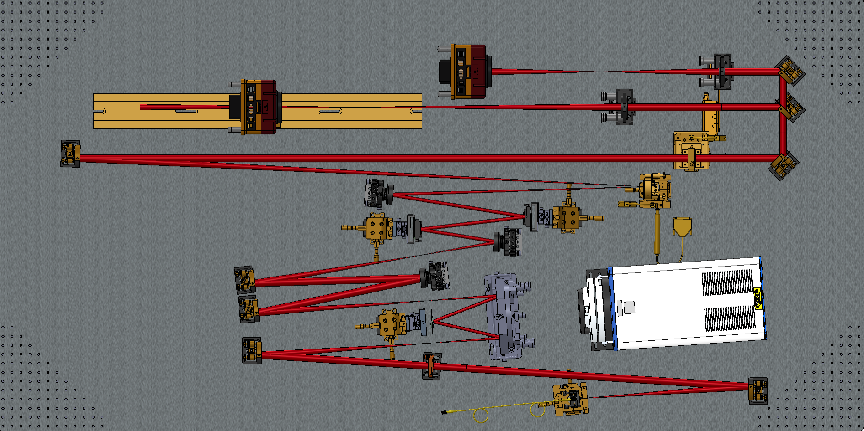
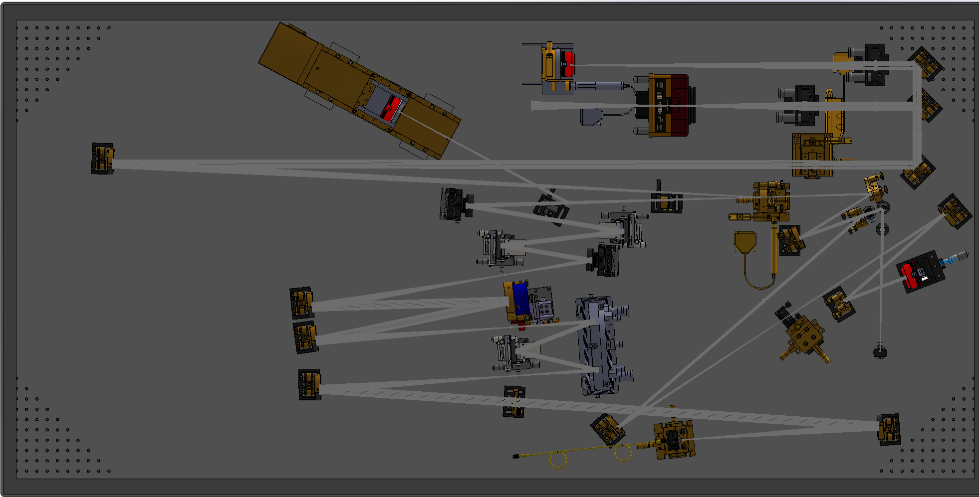
HiCAT Testbed Configuration- Overview
Space Telescope Science Institute February 2017- Present
Original Problems with Testbed:
Outdated
Assembly Errors
Components improperly placed on testbed
Laser beam path needed to change iteratively with each optical set up
Image of Initial HiCAT (High Contrast Imager for Complex Aperture Telescopes) Testbed Configuration prior to design modifications
Responsibilities:
Led the design and manufacturing of new/upgraded optical components on testbed
Laser beam path updated to include Zernike setup by iterating optic component configurations
Image of Upgraded Components
Zernike Set Up

Slide 5
HiCAT Testbed Configuration
4
3
5
2
2
1
2
Image of Upgraded Components
Upgraded Components:
[1] Tip-Tilt Apodizer Mount [2] Deformable Mirror Mount [3] Phase Retrieval Camera Mount
[4] Imaging Camera [5] Lyot Stop Mask

Slide 6
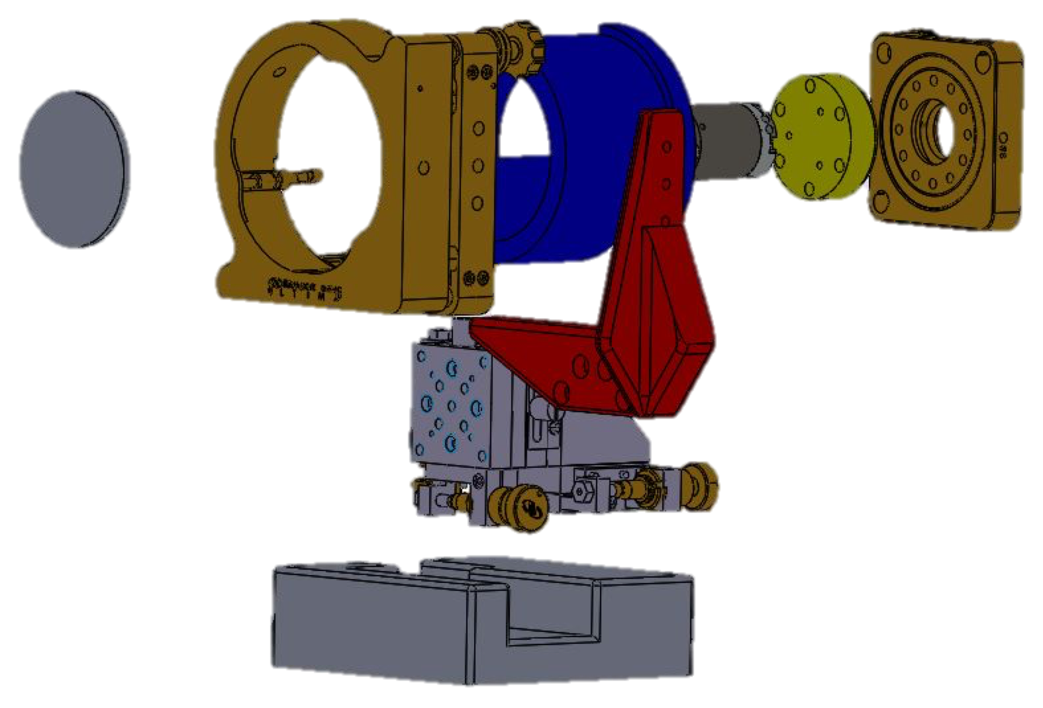
[1] Tip-Tilt Apodizer Mount
Aim: Modify existing Apodizer mount to be compatible with testbed.
Description of Custom Parts:
Red Bracket: designed triangular bracings to keep optic rigidly positioned.
Blue Cage: designed to attach rotation stage to front of yellow adapter while protecting piezoelectric actuator, turned and faced on lathe.
Yellow Adapter: designed to attach back of piezoelectric actuator to rotation stage, turned and faced on lathe to single digit micron accuracy.
Piezoelectric Lens Adapter: designed to attach front of piezoelectric actuator to apodizer optic, turned and faced on lathe and milled to single digit micron accuracy.
Steel Base: designed to maximize accessibility of linear stage knobs and lower the center of gravity of mount to prevent the mount from being falling over.
Rotation Stage
Piezoelectric
Actuator
Linear Stage Knobs
Exploded View of Tip-Tilt Apodizer Mount

Slide 7
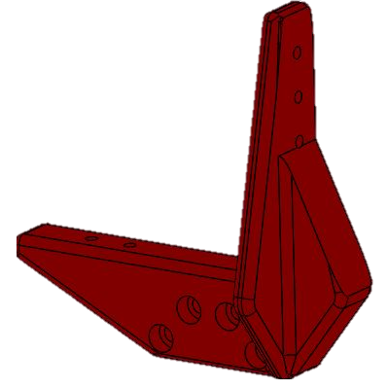
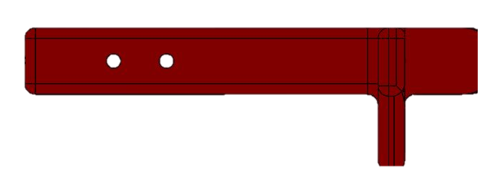
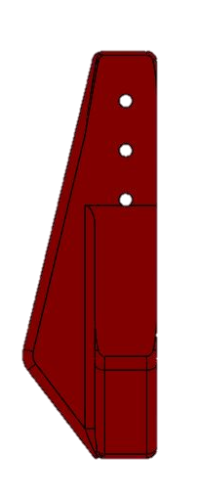
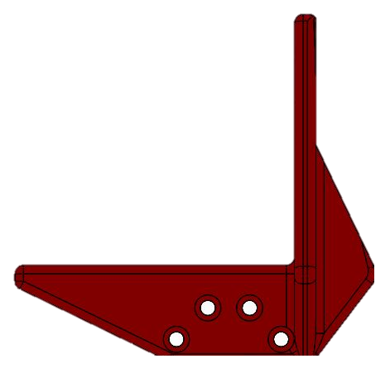
[1] Tip-Tilt Apodizer Mount- SolidWorks Parts
Multiple Views of Red Bracket
Top View
Auxiliary View
Front View
Right View
7

Slide 8
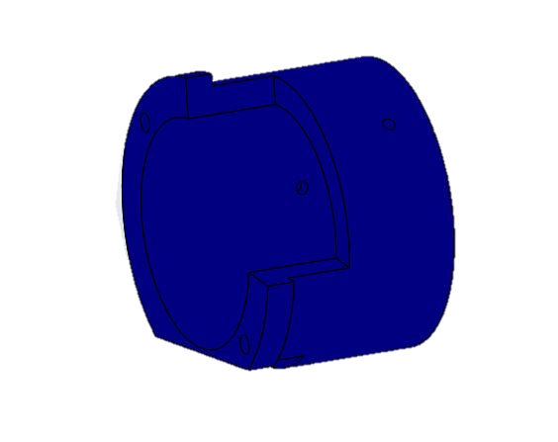
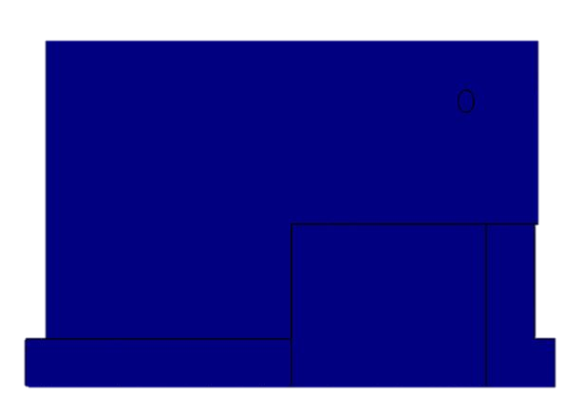
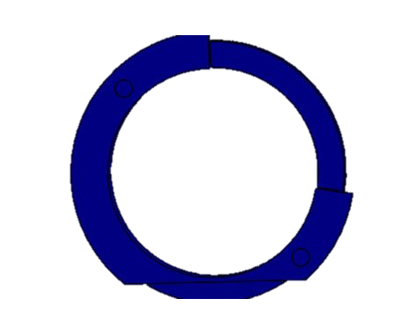
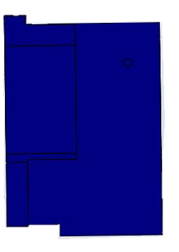
[1] Tip-Tilt Apodizer Mount- SolidWorks Parts
Multiple Views of Blue Cage
Top View
Auxiliary View
Front View
Right View

Slide 9
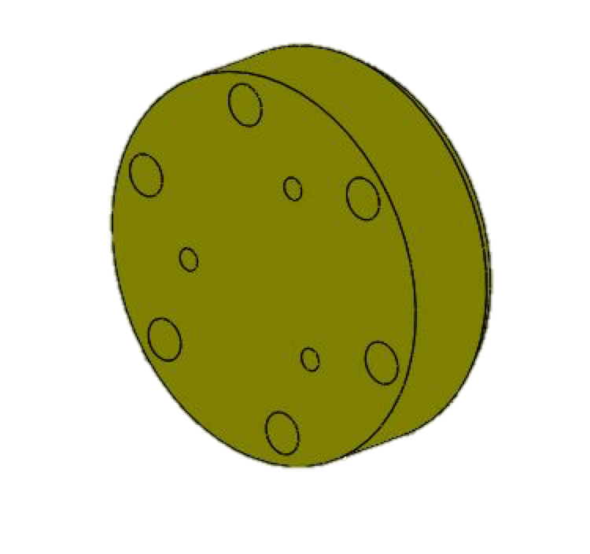
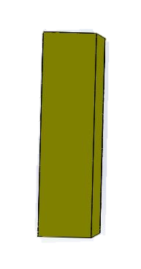
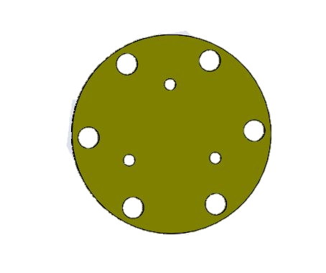
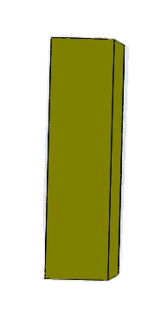
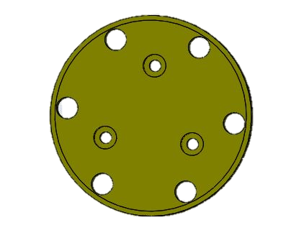
[1] Tip-Tilt Apodizer Mount- SolidWorks Parts
Multiple Views of Yellow Adapter
Top View
Auxiliary View
Front View
Right View
Back View

Slide 10
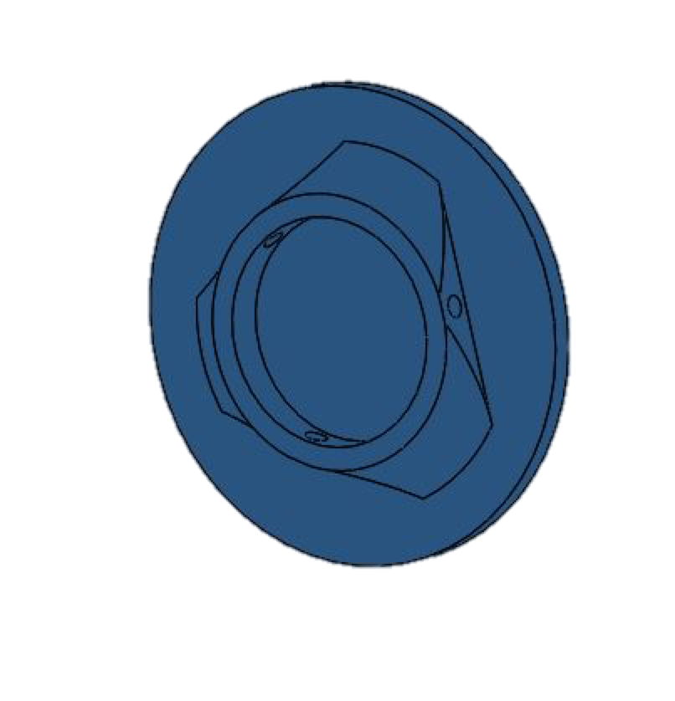
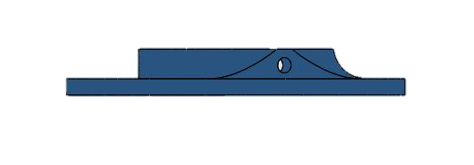
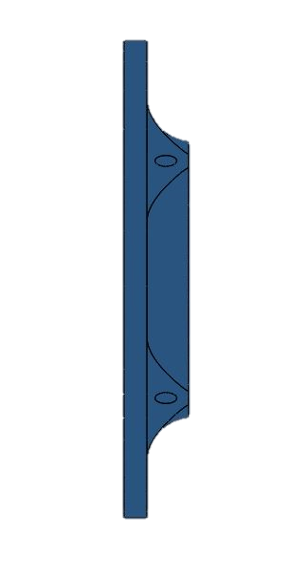

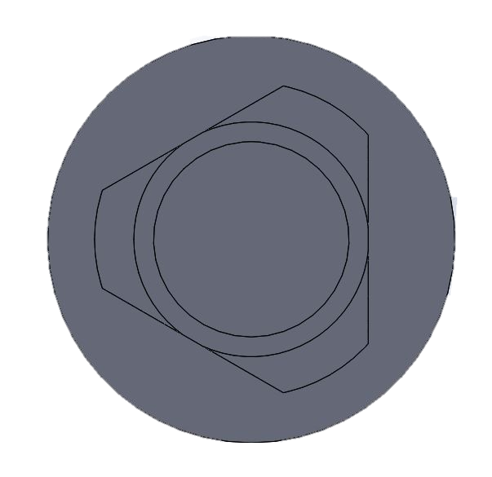
[1] Tip-Tilt Apodizer Mount- SolidWorks Parts
Multiple Views of Piezoelectric Lens Adapter
Top View
Auxiliary View
Front View
Right View
Back View

Slide 11
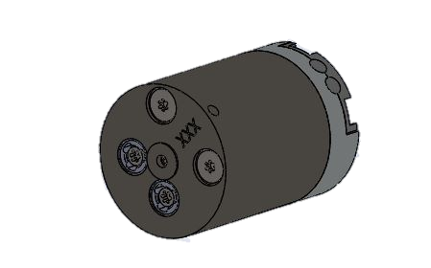
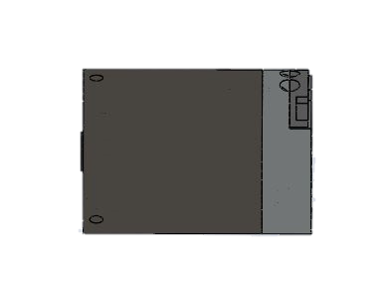
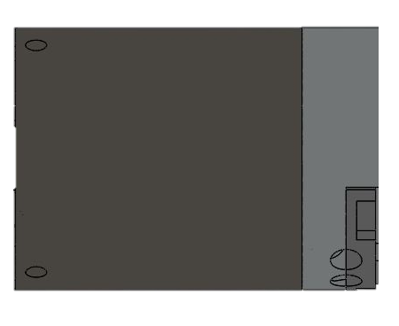
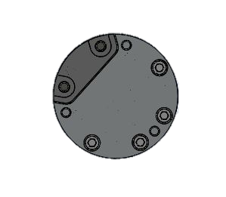
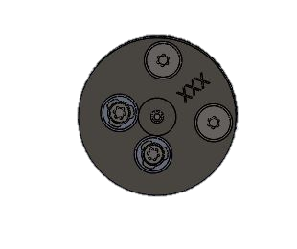
[1] Tip-Tilt Apodizer Mount- SolidWorks Parts
Multiple Views of Piezoelectric Actuator
Top View
Auxiliary View
Front View
Right View
Back View
11

Slide 12
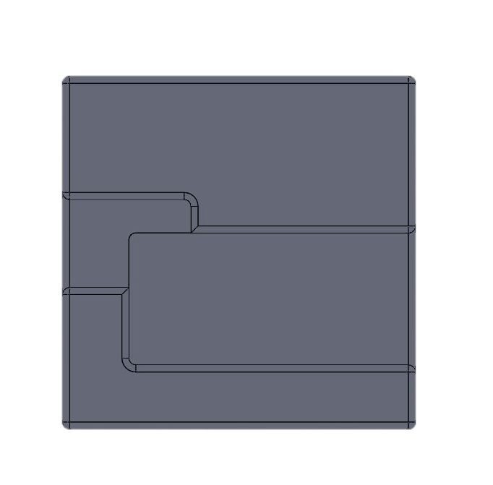
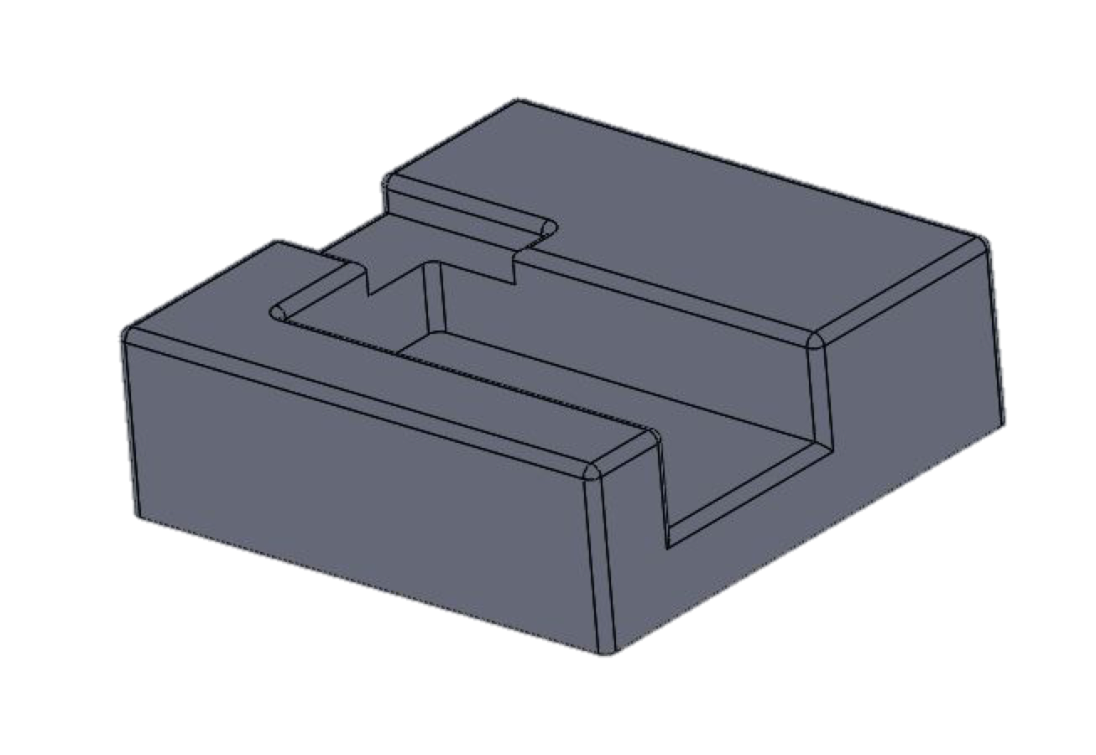
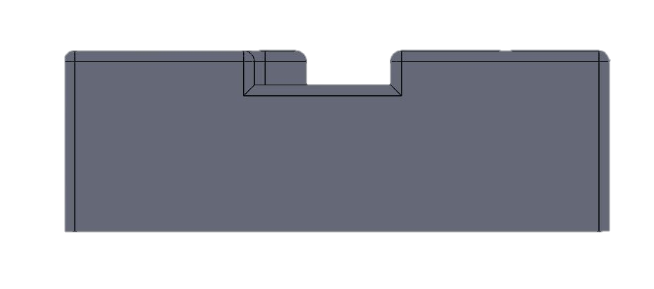

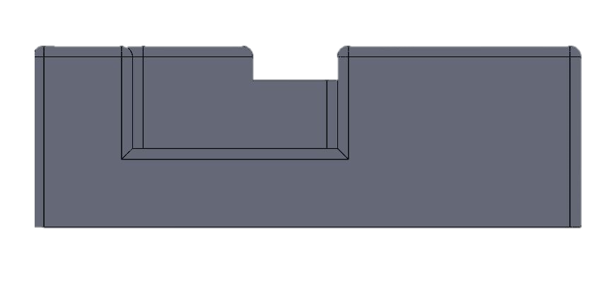
[1] Tip-Tilt Apodizer Mount- SolidWorks Parts
Multiple Views of Steel Base
Top View
Auxiliary View
Left View
Front View
Right View

Slide 13
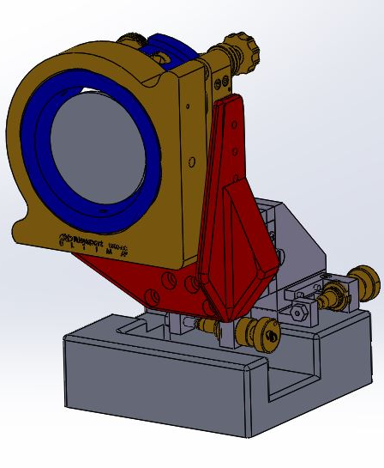
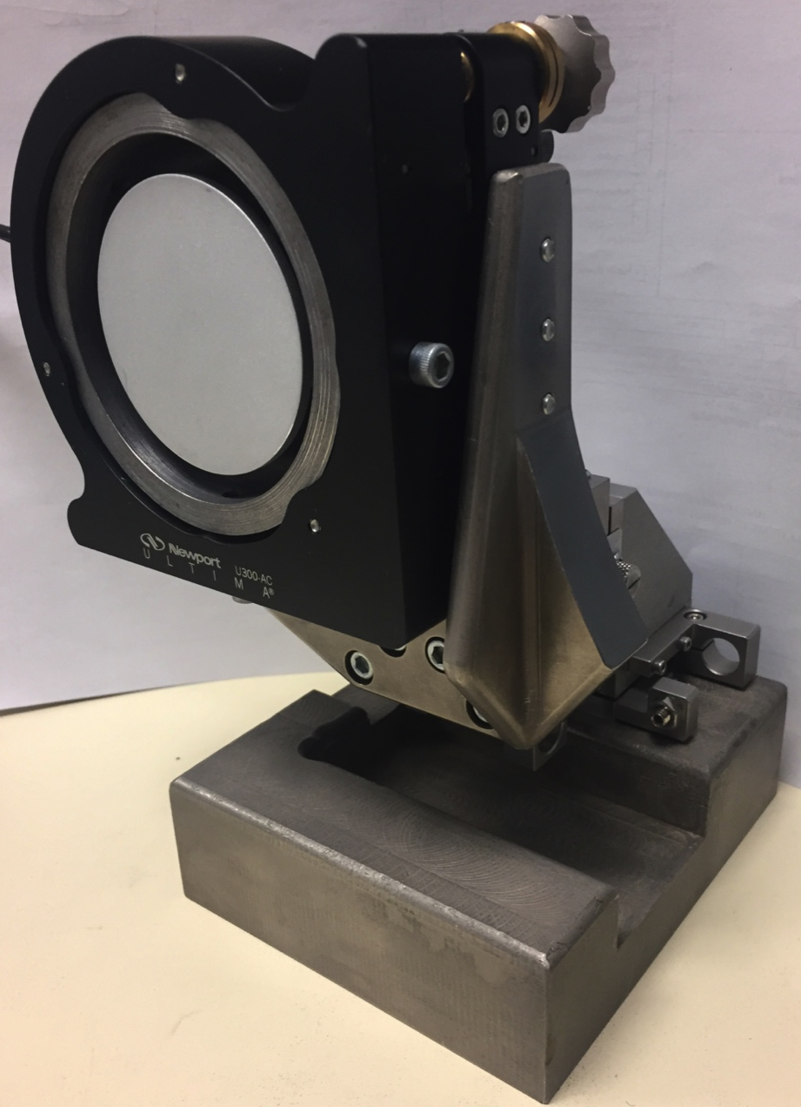
[1] Tip-Tilt Apodizer Mount
Results: Successfully integrated mount onto testbed while having access to linear translation stage knobs
Solidworks Assembly of Tip-Tilt Apodizer Mount
Manufactured Tip-tilt Apodizer Mount

Slide 14
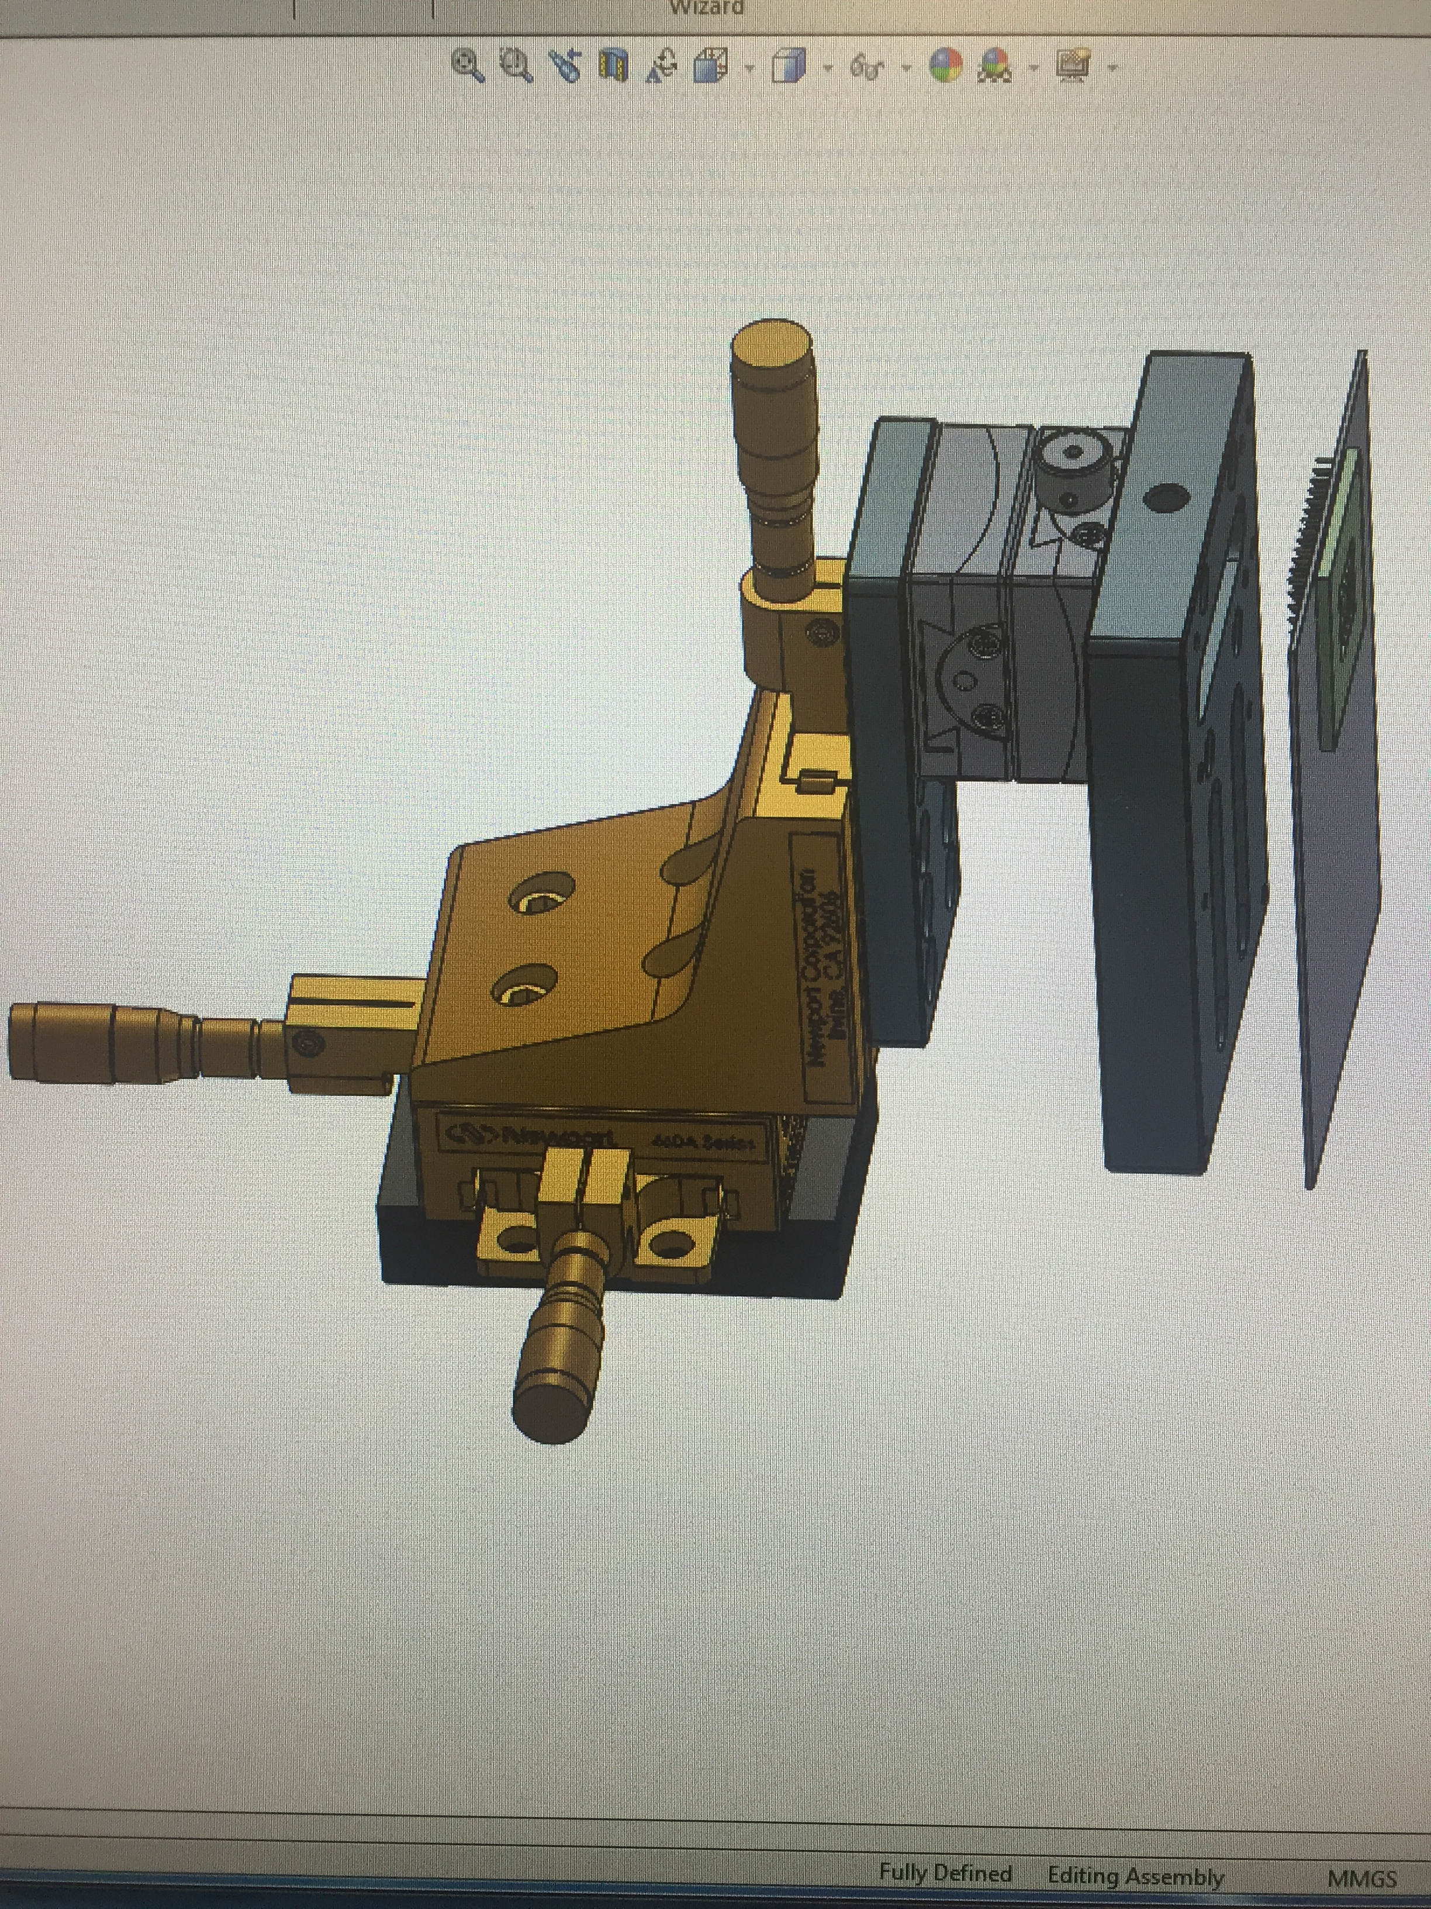
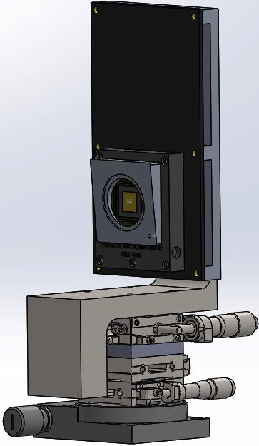
[2] Deformable Mirror Mounts
Aim: Redesign deformable mirror mount to reduce footprint, eliminate cantilever beam bending effects due to the weight of components hanging off the XYZ stage, and increase safety of handling the most expensive optic on the testbed
Results: Successfully integrated deformable mirror mounts onto testbed and ran calibration tests to validate the functionality of the mount.
XYZ Stage
Z Adapter
Rotation Mount
Image of Initial Deformable Mirror Mount prior to design modifications
Image of Upgraded Deformable Mirror Mount

Slide 15
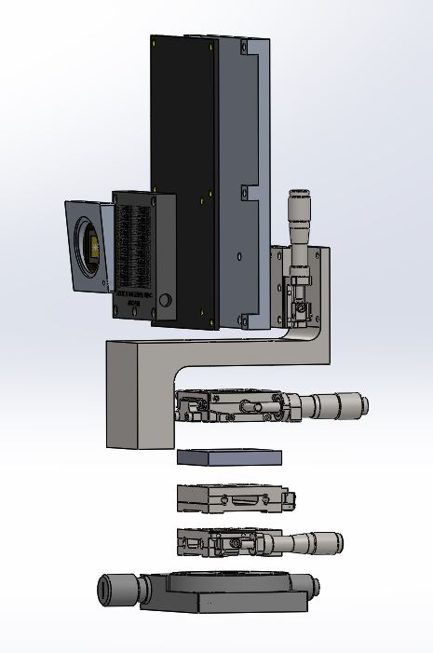
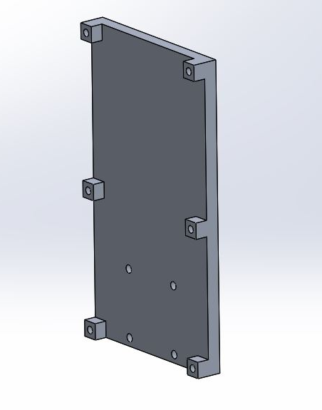
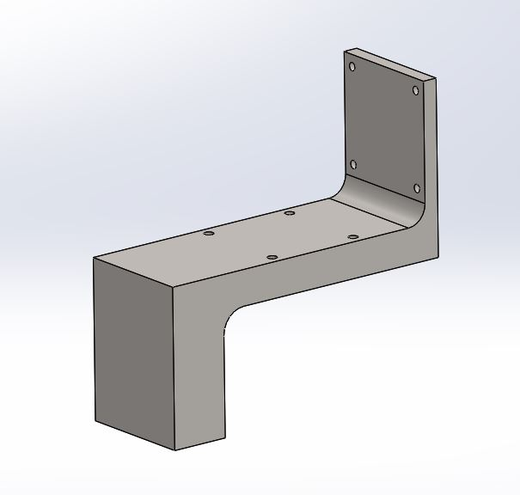
[2] Deformable Mirror Mounts- Exploded View
Description of Custom Parts:
Mount was redesigned to be vertical rather than cantilevered to keep center of mass along the Z-axis of the base rotation stage.
Due to the restricted space on either side of the mount, the Z adapter was designed to extend outward to provide a balancing bending moment to the moment due to the weight of the optics; this was validated using a center of mass analysis
Made 3 identical custom mounts to be used on the testbed
Z Adapter
Mount
Exploded View of Upgraded Deformable Mirror Mount

Slide 16
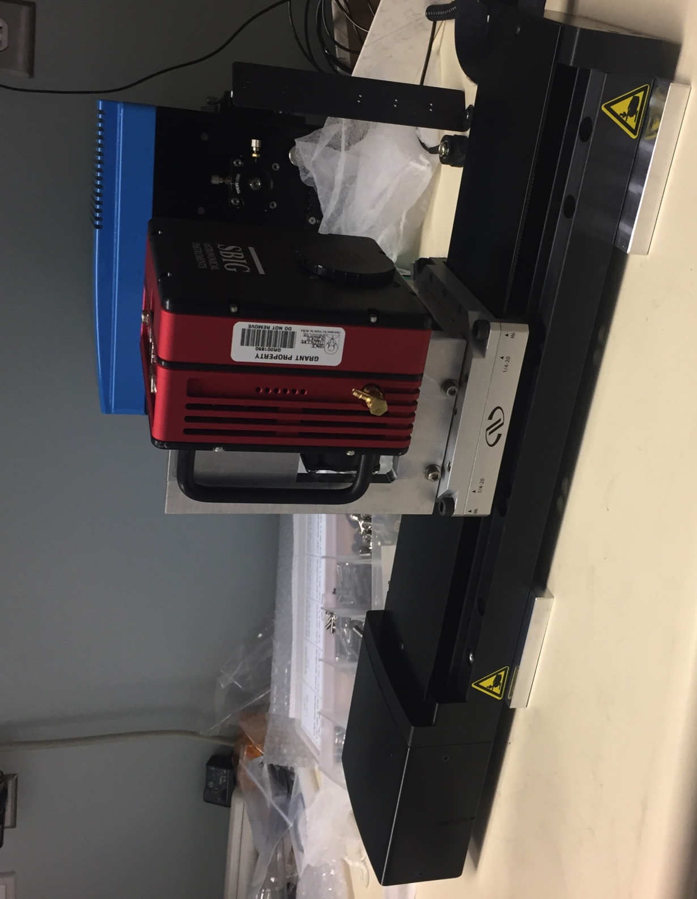
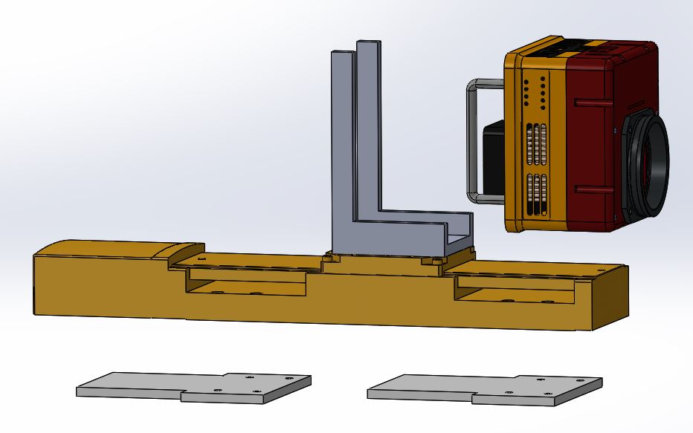
[3] Phase Retrieval Camera Mount
Aim: Design an easily removable mount to rigidly hold a SBIG camera at the optical beam height as it moves along a linear translation stage
Description of Custom Parts:
Designed mount to align with previously drilled & tapped holes on the back plate of the camera
Base plates milled flat to single digit micron accuracy to ensure that center of the camera aperture was at the center of optical beam
Results:
Successfully tested and integrated Phase Retrieval Camera Mount onto testbed
Camera Mount
Base Plates
Exploded View of Phase Retrieval Camera Mount
Manufactured Phase Retrieval Camera Mount

Slide 17
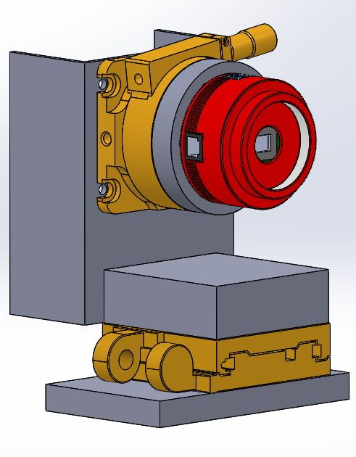
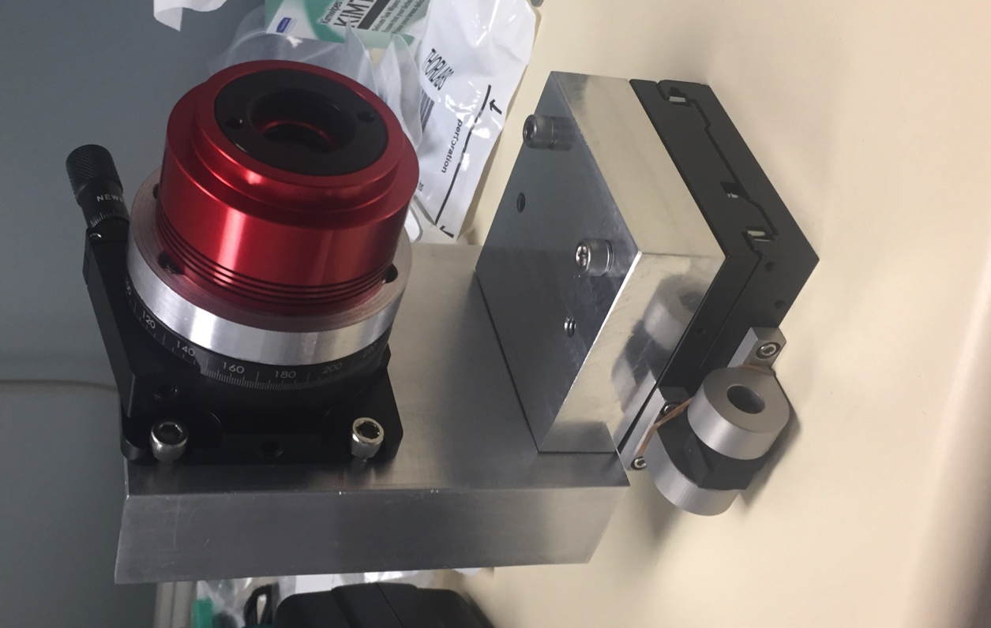
[4] Imaging Camera Mount
Aim: Design and build a mount in the span of 3 days that would support a ZWO camera at the correct optical height and would be compatible with a predetermined rotation stage and translation stage.
Design:
This mount was designed to maximize the moment of inertia of the C bracket and minimize the bending effects due to the cantilevered weight of the rotation stage, adapter and camera.
Results:
Successfully tested and integrated Imaging Camera Mount onto testbed
Solidworks Assembly of Imaging Camera Mount
Manufactured Imaging Camera Mount

Slide 18
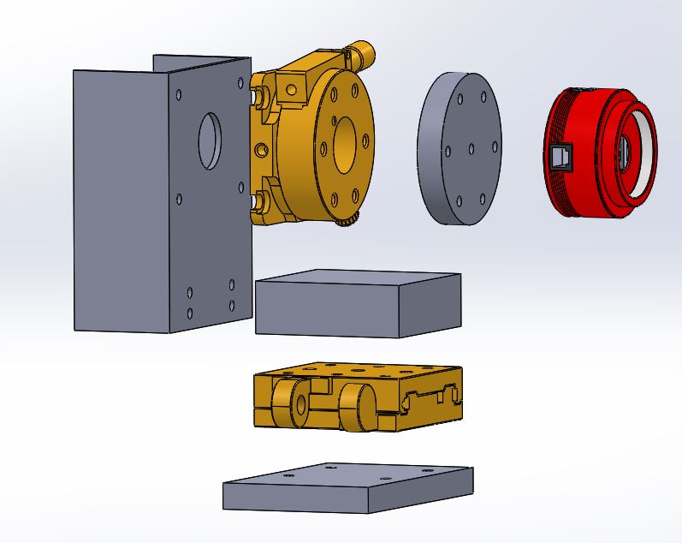
[4] Imaging Camera Mount- Exploded View
Description of Custom Parts:
Camera to Rotation Stage Adapter: Designed to be screwed into the rotation stage with counterbored holes
Attachment of Parts: The camera was attached by putting a screw through the hole on the C bracket & the hole at the center of the rotation stage, and then screwing it into the central counterbored hole on the adapter.
Rotation Stage
Camera to Rotation Stage Adapter
C Bracket
Hole used to mount camera to adapter
Exploded View of Imaging Camera Mount

Slide 19
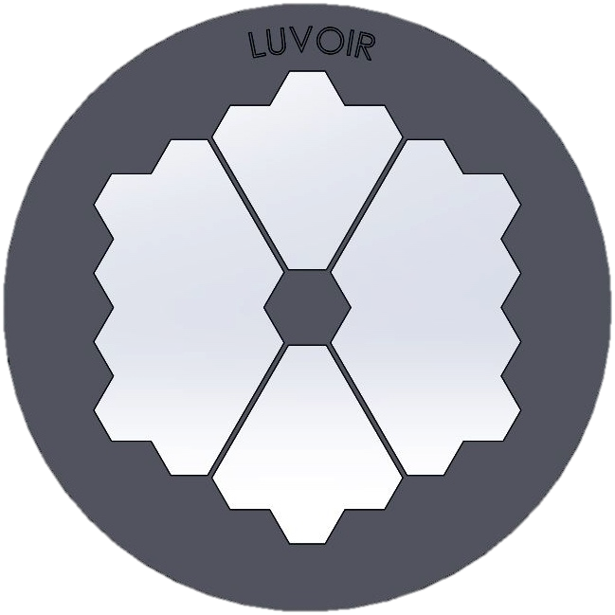
[5] LUVOIR Lyot Stop Mask
Aim: Design a master file of the aperture of the future LUVOIR telescope that can be easily modified
Description of Custom Parts:
Mask was designed to allow for configurations of the spiders, central obstruction, and cut out to be easily made.
Geometric formulas were used to relate dimensions such that changes to the entire design could be made by changing 2 dimensions.
Results:
Successfully created and documented master file that allows non-CAD users to easily change dimensions
Spiders
Central Obstruction
Aperture Cut Out
SolidWorks Design of LUVOIR Lyot Stop Mask

Slide 20
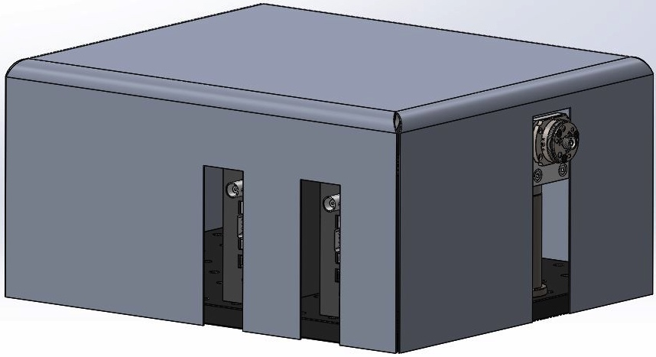
Sheetmetal Laser Cover
Aim: Design a cover to decrease light that may escape from module when low powered laser is operational
Description of Custom Part:
Cover was designed to house various filter wheels, polarizers, and lens along with fiber ports for fiber optic lasers in a safe and sturdy space.
The sheetmetal part was designed as a 2D profile, cut on a waterjet, and bent into shape
Results:
Successfully used on laser source module to decrease light
Fiber Optic
Laser Coupler
Filter Wheel cable ports
Image of SolidWorks Laser Cover

Slide 21
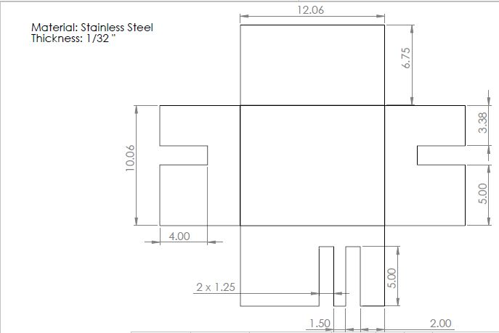
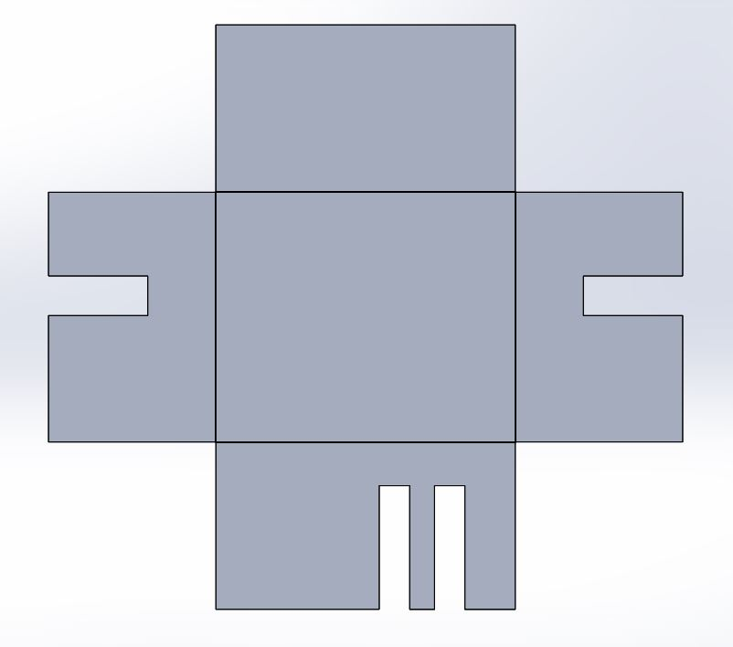
Sheetmetal Laser Cover- Drawing
Material: Stainless Steel
Thickness: 1/32”
Unit: Inches
SolidWorks Drawing of Sheet Metal Laser Cover

Slide 22
Johns Hopkins Senior Design Project
Project Overview
Drill Press Testing Set Up
Door Testing Apparatus
Senior Design Team Poster

Slide 23
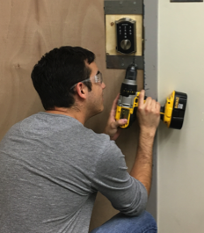
Senior Design Capstone Project- Overview
Johns Hopkins Whiting School of Engineering August 2016- May 2017
Client: Allegion
Aim: Develop an innovative & cheap material solution to boost the security of a Schlage electronic residential lock
Responsibilities:
Spearheaded the effort to redesign the vulnerable regions of the lock and filled these spaces with modularized material inserts
Led the design and manufacturing of testing set up for consistent drill press testing and user experience testing
Results:
Successfully developed 4 material inserts, and recommended 2 material coatings. An evaluation system was implemented to enable 6 users to test 4 inserts in under 15 minutes, mimicking a real-life burglary. These tests provided results that allowed a viable candidate material to be chosen and presented as our final solution.
**NOTE: Due to NDA agreements with Allegion, this portfolio will not go into the details of the solution. The following slides will detail the experimental setups used to test the material solutions
Experimental Drilling Demonstration

Slide 24
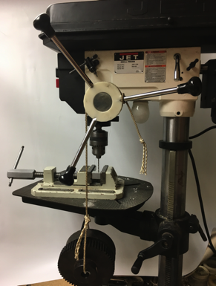

Senior Design Capstone Project- Drill Press Testing
Aim: Test each material insert with a constant drilling force.
Test Description:
A string was wrapped around a pulley and a mass is attached to hang off the end of the pulley
Spring removed from drill press to reduce friction and eliminate torsional spring force
The weight of the mass provided a constant torque to drill into the material insert prototypes.
Results: Successfully calculated the drill rate going through each material insert in order to effectively rank the drill resistance of each material.
Drill press
Custom Pulley
Custom-designed
3D printed pulley
String
Weight (15lbs)
Illustration of Drill Press Test Setup
Drill Press Test Setup

Slide 25
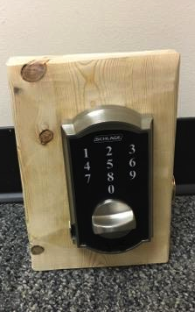
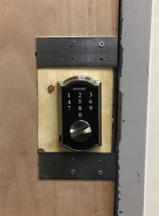
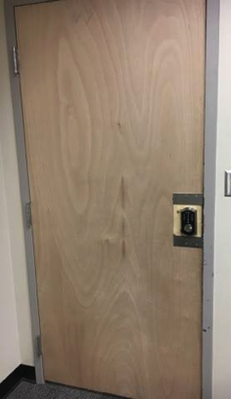
Senior Design Capstone Project- Door Test Apparatus
Aim: Created a repeatable experiment to mimic a robber attempting to breach the lock to test the effectiveness of our material solutions
Test Description:
Locks assembled with different material inserts were mounted onto wooden blocks
Each mounted block slid into a cut out door slot and was secured with aluminum C channels
Results: Created a repeatable test such that the effectiveness of the material solutions could be tested in a realistic scenario
Cutout
8”
5”
Holes for Mounting
Mounted Lock
Door Test Apparatus
Replaceable Test Unit
Inserted Block
Aluminum Channels
Illustration of Door Test Apparatus Setup

Slide 26







ALL17: Harden Locks Against Well Known Attacks
Amanda Canezin, Ashley Canezin, Arturo Brito, Ana Elechiguerra, Sam Pallay
Current Problem:
Considerations for Material Solution:
Hardened material to prevent direct access to locking mechanism
Divert drill bit away from vulnerable regions of lock
Gum up drill bit to render the cutting surface useless
Snag drill bit on fibrous composite material
Strategically place and orient insert to maximize lock protection
Hole can be made
using hand drill
A pin can be used to push
the wall (blue) and engage the deadbolt
Objective:
Develop an inexpensive materials idea that will integrate with the existing supply chain and manufacturing flow to eliminate vulnerabilities
Test Programs:
User Testing: 5 minute test, 4 users, 4 locks/user, 4 materials tested
Drill Press Test: constant force applied, 5 min. test, 20 samples, drill rate recorded
Design Requirements:
Maintain assembly time
Minimize lock modifications
Do not increase costs
Do not compromise functionality
Security Requirements:
BHMA/ANSI 156.30 high security standard
Drill press
Custom Pulley
String
Weight (15lbs)
Proposed Solution:
Phase I: User Testing
Phase II: Drill Press Test
Coating
Discussion & Future Work:
In the drill press test all inserts were fully enclosed in aluminum channels and a vice. In user testing there were gaps between the inserts and lock case, which proved detrimental to the success of some materials. In the future, lock modifications should be made to simplify the insert design and ensure it fits tightly in the lock. Additionally, large scale testing should be completed and manufacturing should be streamlined
Acknowledgements: Mr. Justin Seacat, Mr. Samir Tamer,
Dr. Nathan Scott, Ms. Soraya Bailey, Dr. Iulian Iordachita
Material Insert

Slide 27
Design and Analysis of Dynamic Systems Lab Research
Inverted Pendulum
Videos of Inverted Pendulum

Slide 28

Inverted Pendulum
Design and Analysis of Dynamic System Lab May 2016 - August 2017
Aim: Redesign the control systems lab to use an inverted pendulum rather than a haptic paddle for students in their Junior year to learn about control theory in dynamic systems
Description of Work:
Theoretically solved for the governing equations of the system given various parameters to be used for solving for the stability criterion and implementing PID control
Parts were manufactured using water jet, laser cutter, drill press, mill, and rapid prototyping
Simplified manufacturing process by reducing the number of manufactured parts, streamlining assembly of components, and documenting process for future pendulum replicas
Results:
Successfully designed and manufactured pendulum
components as well as aided in implementing PID
control to balance pendulum upright even when
external perturbations were introduced to the system
Image of SolidWorks Inverted Pendulum

Slide 29


Videos of Inverted Pendulum
Description: Video of students testing limits of stability criterion of the inverted pendulum as well as video of an inverted pendulum’s behavior as PID control is approaching stability
Video of students interacting with pendulum
Video of pendulum behavior when approaching stability

